Slide 1
DESIGN THINKING
SECTION-D TEAM NO:4
HEALTH ISSUES OF
SOFTWARE EMPLOYEES

Slide 2

HEALTH ISSUES
SDG:3
Health is combination of physical and mental state.

Slide 3


THEME
OBJECTIVE OF THE STUDY:-
TO study the health issues faced by employes in software companies with regard to working hours and their perception towards WORK- Life Balance factors in software industry.

Slide 4
EMPATHIZE

Slide 5
PRIMARY RESEARCH

Slide 6
PROBLEMS FACED BY IT EMPLOYES
Extended screen time Staring at a screen all day can exhaust us.
Increased stress Work can be stress-inducing at the best of times.
Back pain .poor posture is almost every office workers health problem .
They are unable to take food at time due to their office timings due to this they are getting acidity .
Mental health .
Obesity .

Slide 7
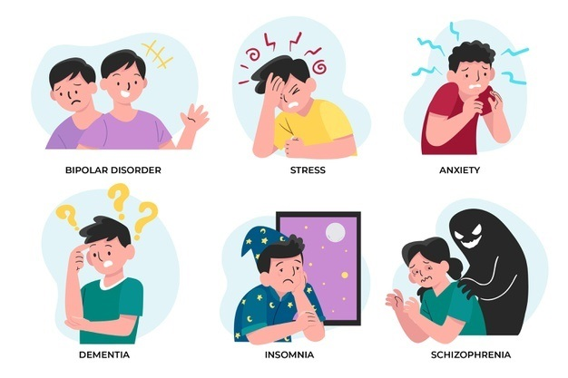
HEALTH ISSUES:
IT EMPLOYES

Slide 8
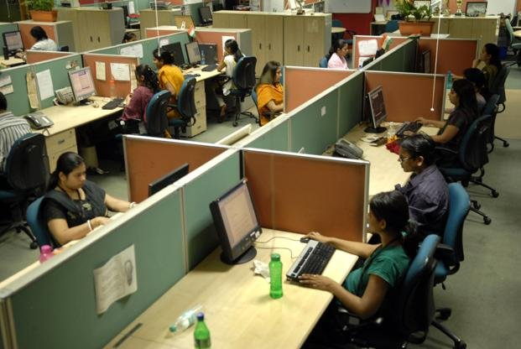
Q/A
Q.HOW DO YOU FEEL ABOUT YOUR WORK LIFE ?
A:It is good but due to heavy work we are facing many health issues.
Q.WHAT ARE THE HEALTH ISSUES YOU ARE FACING ?
A.
Improper intake of water
Continous sitting which leads to backpain, stomach problems, joint pain
Eyesight problem
Obesity
Computer vision syndrome
Q.WHAT KIND OF HEALTH ISSUES YOU ARE FACING DUE TO SHIFTS?
Depreesion
Obesity
No proper sleep, food
Psycological problems

Slide 9
SECONDARY RESEARCH

Slide 10
Eating healthy is essential for software employees to maintain their health and productivity. By providing advertisements about healthy food, software companies can encourage their employees to adopt better eating habits. For example, an advertisement of a nutritious meal plan or healthy snacks could be displayed on the company bulletin board or website. In addition, the company could also sponsor activities such as healthy cooking classes or nutrition seminars. These initiatives would help employees become more aware of the importance of healthy eating and encourage them to make healthier food choices. By increasing awareness and promoting healthy habits, software companies can help their employees enjoy better overall health.

Slide 11
MENTAL HEALTH
36% Indian employees suffering from mental health issues: Survey
By India Today Web Desk: A recent survey revealed that in India, 50% employees are worried about an uncertain future due to the Covid-19 pandemic. The survey by The7thFold showed that this was the top stress factor, followed by by personal finances (40%) and career growth (40%).
The high levels of stress that have emerged and continue to amongst India Inc employees during the ongoing lockdown is a huge area of concern. Stress is the biggest trigger factor which impacts mental and physical wellbeing. the lesser or the more managed the stress levels, the better the overall wellbeing.
Software professionals may spend more than seven hours per day in front of a laptop or a desktop. The companies employing them , most often, fail to provide a healthy environment that does not compromise health.
Health issue which are found out in the initial stage can be treated and they can react accordingly. Unhealthy food habits
have caused obesity and insomnia in employees working in software companies. Depending on the shift jobs which they work for . Proper scheduled food habits and counselling may lead to healthy work life and employee engagement in software industries.

Slide 12
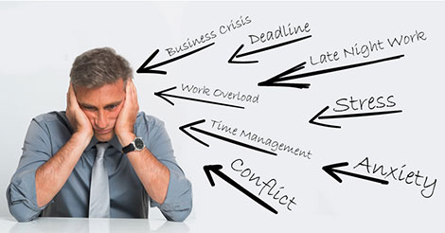
How stress affects the body
Frequent headaches
Muscle tension
Body pain
Inexplicable fatigue
Stomach problems
Bloating and acidity
Either too much sleep or no sleep at all
Anxiety and restlessness
Unable to concentrate on any task
Crying and irritability
Anger and negative thoughts

Slide 13
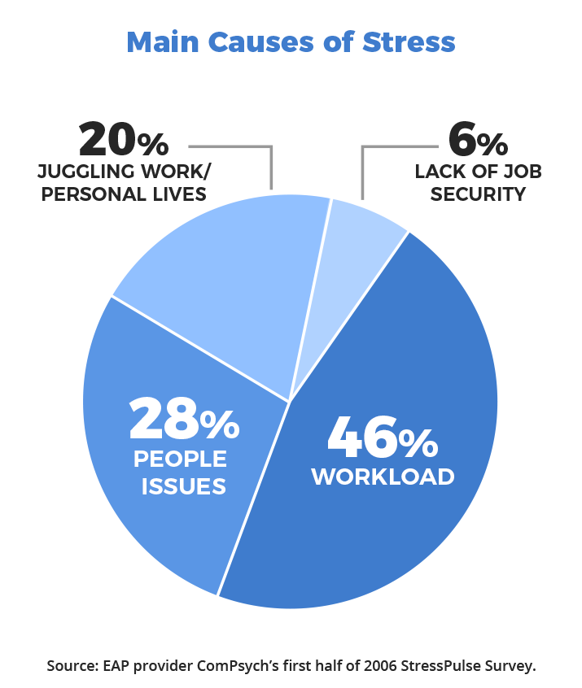
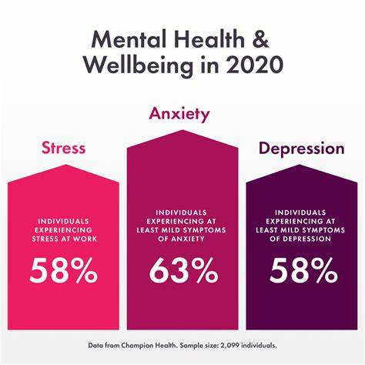

Slide 14

USER WANTS AND NEEDS
SAY WANTS CONVIENCE FREE TIME | THINK REDUCE WORKING HOURS PLEASANT WORKING ENVIRONMENT
DO DRINKS COFFEE USING SMARTPHONES HAVING SOME FUN WITH COLLEGUES | FEEL STRESS ANXIETY DEPRESSION HYPERTENSION

Slide 15

WANTS
GOOD ENVIRONMENT TO WORK
HEALTH CONSCIOUS FOOD
LESS WORKING HOURS
TAKING LOTS OF WATER
NEEDS
PROPER FOOD
PROPER SLEEP
SMALL BREAKS IN WORKING TIME
INSIGHTS
EMPLOYEES WILL GIVE YOU THEIR BEST WHEN THINGS THEY DEEM AS SIGNIFICANT ARE IMPLEMENTED AT THE WORKPLACE.

Slide 16
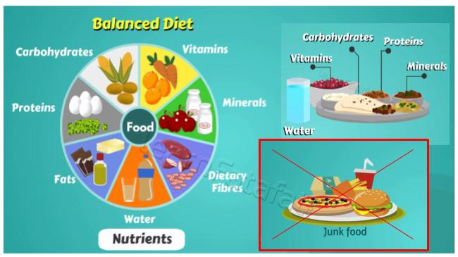
NUTRITIOUS FOOD
SOFTWARE EMPLOYEES
ARE NOT INCLUDING NUTRIENTS IN THEIR DIET.
HEALTH IS A STATE OF MIND & BODY.
ADOPTING HEALTHY HABITS ALLOWS YOU TO TAKE CHARGE OF BOTH YOUR PHYSICAL AND MENTAL HEALTH,AS WELL AS POSITIVELY.

Slide 17

A BALANCED DIET SHOULD OFFER
60-70% OF TOTAL CALORIES FROM CARBOHYDRATES
10-12% FROM PROTEINS
20-25% FROM FAT

Slide 18
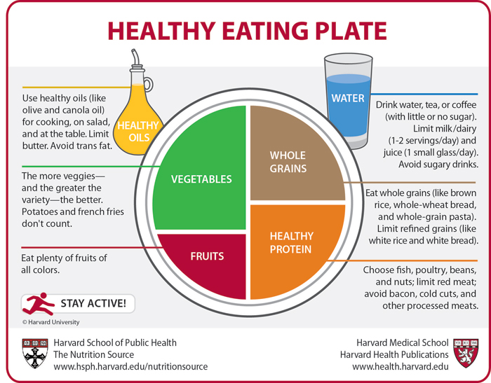
40%-FRUITS AND VEGETABLES
8% DAIRY AND ALTERNATIVES
12% BEANS,PULSES,
FISH,EGGS,MEAT
1% OIL AND SPREADS

Slide 19
DEFINE

Slide 20
WHY
AS THEY ARE HAVING UNHEALTHY FOOD
WHY
AS THEY ARE NOT INTERESTED IN COOKING FOOD
WHY
BECAUSE DUE TO HEAVY WORK THEY ARE PREFFERING FOOD APPS TO ORDER FOOD
WHY
WHY
INFLUENCED BY ADVERTISEMENTS OF FOOD APPS AND SOCIAL MEDIA
AS THEY ARE PROVIDING OFFERS,GIVING DISCOUNTS & NEW MENU TO ATTRACT PEOPLE
… 5 WHY’S …
HEALTH ISSUES FACED BY SOFTWARE EMPLOYES

Slide 21
HOW MIGHY WE
1.HOW MIGHT INFLUENCE SOFTWARE EMPLOYEES TO COOK THEIR OWN FOOD.[SERVICE]
2.HOW MIGHT WE MAKE SURE THAT THEY REDUCE USING FOOD APPS.
3.WHAT IF WE COULD MAKE THEM CARRY SOME DRY FRUITS ALONG WITH THEM.
4.WHAT IF WE COULD MAKE THEM HAVE DAILY PROTEIN DRINKS OR SOME
FRUIT/VEGETABLES DRINKS.[PRODUCT]
5.WHAT IF WE DISPLAY ADS ABOUT NUTRIOUS FOOD IN THE OFFICE.[PRODUCT]
6.WHAT IF WE INCREASE OFFERS ON NUTRITIONS FOOD.[SERVICE]
7. HOW MIGHT WE PREPARE THE TIME TABLE FOR SOFTWARE PEOPLE TO GET FREE TIME TO PREPARE THERE OWN FOOD.[EXPERIENCE]
8.HOW MIGHT WE INCERESE THE PRODUCTION OF HEALTHY FOOD.
9.HOW MIGHT WE CREATE AWRENESS ABOUT NUTRIOUS FOOD FOR SOFTWARE EMPLOYEES.
10.WHAT IF WE INCREASE ORGANIC STORES AROUND THE OFFICE.[PRODUCT]
11.WHAT IF THE FOOD APPS SHOWS WHAT KIND OF NUTRIENTS TO TAKE & HOW MANY CALORIES IT CONTAIN.[PRODUCT]

Slide 22
CONCLUSION ABOUT HOW MIGHT WE
HOW MIGHT WE ENSURE THAT SOFTWARE EMPOLYES CAN HAVE NUTRITIONS FOOD IN THEIR DIET.

Slide 23
FINAL CONCLUSION STATEMENT:-
SOFTWARE PEOPLE ARE ADDICTED TO FOOD APPS FOR JUNK FOOD DUE TO NO TIME AND NOT INTERESTED IN COOKING AND INFLUENCED BY ADVERTISEMENT AND SOCIAL MEDIA.

Slide 24
IDEATE

Slide 25
IDEATION | DESIRABILITY | FEASIBILITY | VALIABILITY
1.HOW MIGHT WE INFLUENCE SOFTWARE EMPLOYES TO COOK THEIR OWN FOOD. | ✔ | ✔ | ✔
2.HOW MIGHT WE MAKE SURE THAT THEY REDUCE USING FOOD APPS. | ✔ |  | ✔
3.WHAT IF WE COULD MAKE THEM CARRY SOME DRY FRUITS ALONG WITH THEM. | ✔ | ✔ | ✔
4.WHAT IF WE COULD MAKE THEM HAVE DAILY PROTEIN DRINKS OR SOME FRUIT/VEGETABLES DRINKS. | ✔ | ✔ | ✔
5.WHAT IF WE DISPLAY ADS ABOUT NUTRIOUS FOOD IN THE OFFICE. | ✔ | ✔ | ✔
6.WHAT IF WE INCREASE OFFERS ON NUTRITIONS FOOD. | ✔ | ✔ | ✔
7. HOW MIGHT WE PREPARE THE THE TIME TABLE FOR SOFTWARE PEOPLE TO GET FREE TIME TO PREPARE THERE OWN FOOD. | ✔ |  | ✔

Slide 26
 | DESIRABILITY | FEASIBILIY | VALIABILITY
8.HOW MIGHT WE CREATE AWARENESS ABOUT NUTRIOUS FOOD FOR SOFTWARE EMPLOYEES. |  | ✔
9.WHAT IF WE INCREASE ORGANIC STORES AROUND THE OFFICE. | ✔ |  | ✔
10.WHAT IF THE FOOD APPS SHOWS WHAT KIND OF NUTRIENTS TO TAKE & HOW MANY CALORIES IT CONTAIN. | ✔ | ✔ | ✔

Slide 27
IDEAS
It is important for software employees to have good nutrition in order to stay healthy and productive. Here are some solutions that can be implemented to improve the health of software employees through nutrition:
1. Provide Healthy Snacks: It is important to provide healthy snacks in the workplace. By offering healthy snacks such as fruits and vegetables, employees can more easily access nutritious options when they need a quick energy boost.
2. Educate Staff on Nutrition: Educating staff on nutrition can help them make better decisions about their dietary habits. By providing nutritional information, software employees can be more aware of the foods they should be eating to stay healthy and energized.
3. Encourage Healthy Lunch Breaks: Encouraging software employees to take regular lunch breaks can help them stay energized and productive. Allowing employees to use their lunch break to go outside and get some fresh air, or to go to a nearby park or cafe can help give them a break and provide more healthy eating options.
4. Provide Healthy Meals: Offering healthy meals at the workplace is a great way to make sure software employees are getting the nutrition they need. Providing meals such as salads and sandwiches can help ensure employees are getting the vitamins and nutrients they need throughout the day.
By implementing these solutions, software employers can ensure their employees are getting the nutrition they need to stay healthy and productive.

Slide 28
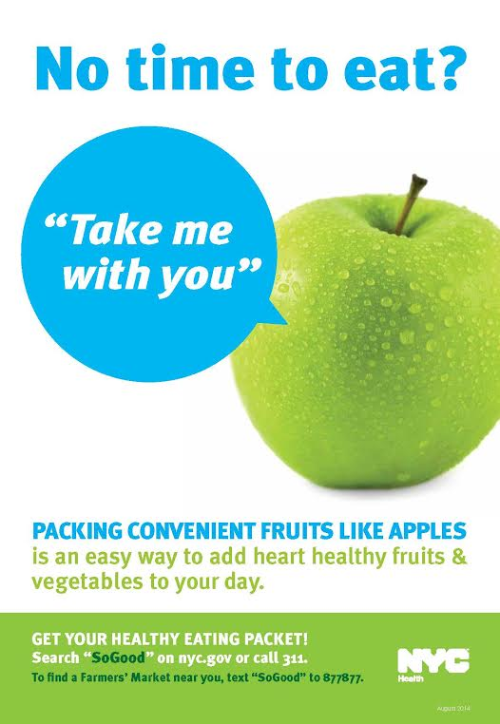
BUILD YOUR IDEA
NAME : ADVERTISEMENTS
TITLE : DISPLAY OF ADVERTISEMENTS ABOUT NUTRITIOUS FOOD
VALUE TO USER : THEY GET TO KNOW MORE ABOUT HEALTHY FOOD
AND GET INFLUENCED BY IT
VALUE TO ORG : MAKING PROFITS
SDG IMPACT : IT HELPS THE 3 SDG GOOD HEALTH AND WELL BEING
ASSUMPTIONS:
1.TIE UP WITH BIG COMPANIES FOR GIVING ADS ABOUT HEALTHY FOODS
2.BY PAYING AMOUNT TO THE RESTAURANTS IN THE MALLS TO DISPLAY ADS

Slide 29
VALUE PROPOSITION MAPPING
STAKEHOLDER GROUP : SOFTWARE EMPLOYES
 | STAKEHOLDER | SOLUTION
NEEDS | THEY NEED TO GET PROPER NUTRITIOUS FOOD&SLEEP | MAKE THEM COOK THEIR OWN FOOD OR HAVING DRY FRUITS DAILY HAVING A NUTRITIONS CAFETERIA (ONLY WITH ORGANIC ITEMS THE FOOD IS PREPARED)
WANTS | THEY WANT FREE TIME OR REDUCE WORKING HOURS | MAKING TIME TABLE IN SUCH A WAY THEY CAN HAVE FREE TIME AND LIMITED WORKING HOURS

Slide 30
PROTOTYPE

Slide 31
SOLUTION :-
TO CREATE A HEALTH AND FITNESS APP WITH SOME SPEACIAL FEATURES WHICH CAN USEFULL FULL AND MOTIVATES EMPLOYEES HEALTH AND TO MAINTAIN GOOD DIET.
CALORIE TRACKER
STEP COUNTER
TIME TABLE(SCHEDULE DESIGNING)
WORKOUT MANUAL
DIET MENU
REMINDERS
HEART BEAT
YOU CAN DIRECTLY CONNECT WITH DOCTERS
NEAR BY GYMS AND FITNESS CENTRES
SEND REPORT TO FAMILY
WE CAN MAKE FRIENDS AND ASK THEM HOW THEY MANAGE DAILY SCHEDULE,WE CAN CHAT WITH THEM
IT DIRECTLY CONNECTS TO LINKEDLN PROFILE
FOR CONSISTENT PERFORMERS IT AWARDS SOME POINTS WHICH CAN REDEEM AS GIFT CARDS,COUPONS, AND LEAVES
IN APP IT SHOWS ADS ABOUT HEALTHY FOOD,SNACKS ,DRY FRUITS ,ETC..

Slide 32
IT REQUIRES COMPANY ID AND PASSWORD TO LOGIN
ONLY EMPLOYEE OF THAT COMPANY CAN LOGIN
SMART BAND
IT DIRECTLY CONNCETS TO COMPANY SERVER
WE HAVE TO TAKE PARTNERSHIP WITH COMPANY,ORGANIC FOOD SOURCE ,DELIVERY SEVICE,ETC..
WE HAVE TO ADVERTISE AND MARKETING FOR THIS APP TO SPREAD THIS
AS MANY EMPLOYEES USE MOBILES IT IS EASY TO TO IMPIMENT THIS
BY HEALTHY COMPITISION IN EMPLOYEES THEY PUT SOME INTREST TO MAINTAIN GOOD HEALTH..

Slide 33

APP NAME : VITALITY
{PERSON’S ABILITY TO LIVE , GROW, AND DEVELOP}
LOGIN ID:
PASSWORD:
FORGET PASSWORD

Slide 34
1-MAIN MENU
2-SOCIAL MEDIA PART
3- SCHEDULE
4-STORE
5-PROFILE
WORKOUT MANUAL:
DIET MENU:
WE CAN CHECK OUR PROGRESS IN PROFILE SECTION
1 2 3 4 5

Slide 35
1.MAIN MENU
IN MAIN MENU WE CAN ABLE TO SEE WORKOUT MANUALS,DIET MENU PLANS,STEPS, HEART RATE ,CALORIE COUNTER(BURNT) ,ETC
2.SOCIAL MEDIA SECTION
PEOPLE CAN CHAT WITH THERE COLLEAGUES , AND SEE HOW THEY ARE PERMORMING
AND THERE PROGRESS IN COMPANY , EVEN THEY ASK DOUGHTS ABOUT WORK.
3.SCHEDULE
WE CAN MANAGE YOUR SCHEDULE HERE AND BE CONSISTENT IN WORK.YOU CAN SEE WHAT WORK YOU HAVE TO DO.YOU HAVE REMINDERS.YPU CAN SEE PROGRESS OF YOUR PROJECTS IN COMPANY.
4.STORE
WE CAN BUY SOME DRY FRUITS , SNACKS, ORAGANIC FOOD IN LESS PRICE.
YOU HAVE SOME DISCOUNTS.IF YOUR PROGRESS IS GOOD YOU HAVE SOME HIGH DISCOUNTS.
5.PROFILE
WE CAN SEE YOUR PROGRESS IN PROFILE.YOUR PAST PERFORMANCE.ALL YOUR ACCOUNT ACCESS

Slide 36
TEST

Slide 37
This health and fitness app sounds like a great idea! It has a lot of potential to help motivate employees to stay healthy and maintain a good diet. The features you listed are very comprehensive and it looks like the app could be a great success.
The calorie tracker and step counter are great for tracking progress and helping people keep track of their goals. The time table feature for scheduling and the workout manual for guidance would be really useful. The diet menu and reminders could also be helpful for people who need that extra push to stay on track.
The ability to connect with doctors and find nearby gyms and fitness centers is also a great idea. Having a social aspect, where users can make friends and chat with them, could be a great way to stay motivated and have some friendly competition.
Finally, the rewards system for consistent performers is a great way to add an incentive to keep going and stay motivated. The ads featuring healthy food and snacks is also a nice touch.
All in all, this health and fitness app is a great idea with lots of potential - it looks like it could be a big success!

Slide 38
The app can also feature ads about healthy food, snacks, and dry fruits, giving users more access to health-promoting products and services. For example, the app could display ads for new vegan restaurants in the area or for healthy prepared meals that can be delivered to the user’s home.
Overall, this health and fitness app could be a great tool for users to better manage their diet and lifestyle. With its helpful features and access to health-promoting products, this app could make a big difference in helping people stay healthy and motivated.

Slide 39
WORK LOG
STUDENT NAME | WORK DONE
ANKITHA .D | GATHERED INFORMATION ABOUT EMPATHIZE & IDEAS ABOUT HOW MIGHT WE
NAVYA SREE.A
NANDHU TEJA.C | IDEAS
POOJITH.E
MALLIKARJUNA.G | PROTOTYPE & PPT
VISHNU SAI RAM.CH

Slide 40
…THANK YOU…

